Slide 1
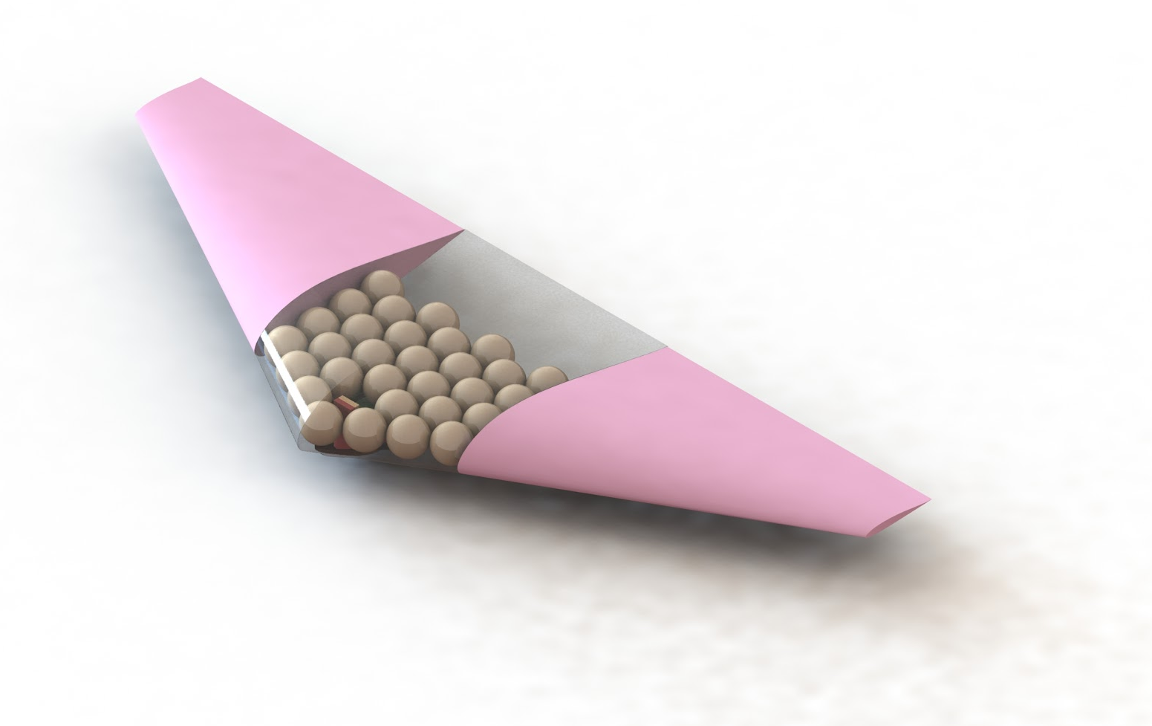
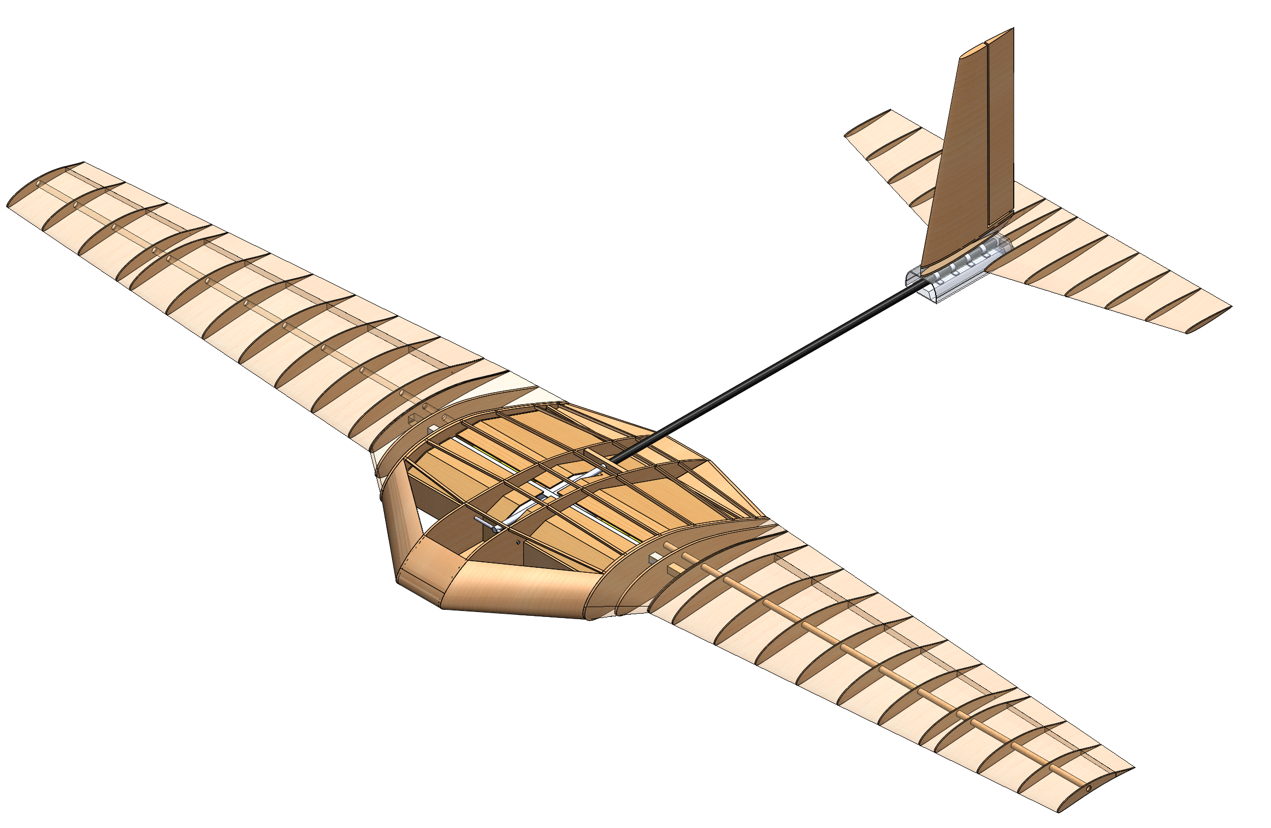
Subscale Mars Colonization Mission
SAE Aero Design West 2019 - Advanced Class
ME:
Riley Evers
Cameron LaMack
James Lumsden
Sean Nevin
Alexa Poulakos
Donner Schoeffler
Skyler Tan
Siraj Zaman
EE:
Anthony Modica
Ali Altamimi
CS:
Anthony Keba
Advisor: Emin Issakhanian
Loyola Marymount University
Mechanical Engineering
07 Nov 2018

Slide 2
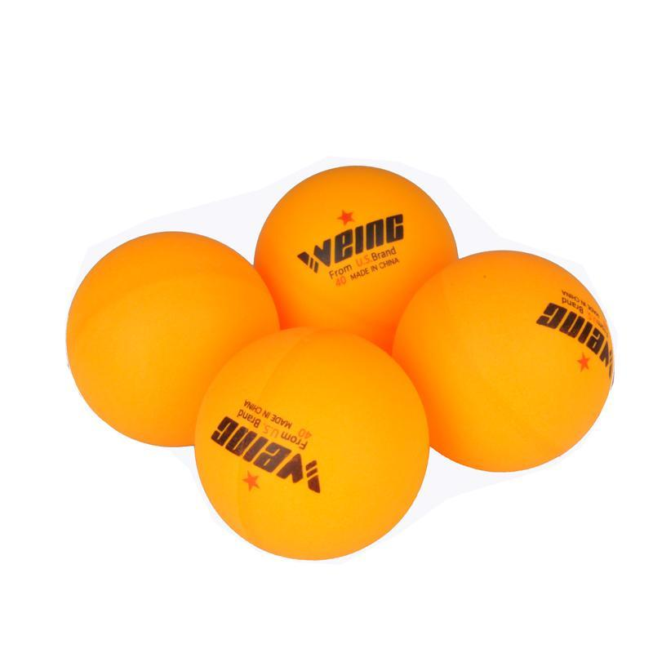
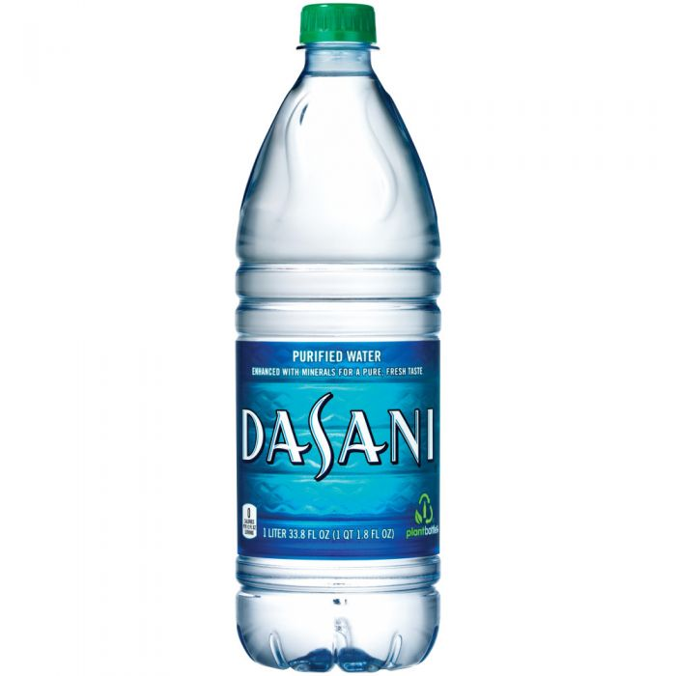
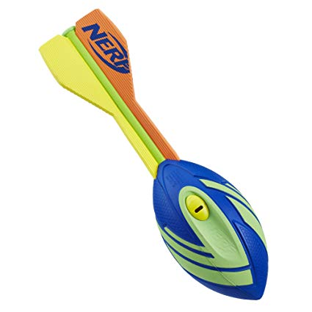
SAE 2019 ADVANCED CLASS OBJECTIVE
Deliver “colonists”, “habitats”, and “supplies” to designated landing zone
Colonists are delivered using small autonomous gliders carried by a primary aircraft
Other payloads are dropped from primary aircraft
“Colonists”
“Habitats”
“Supplies”

Slide 3
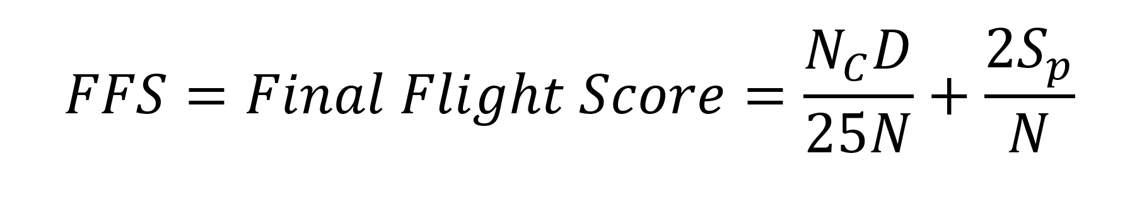
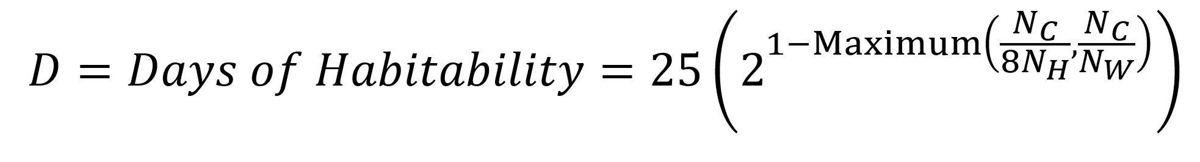
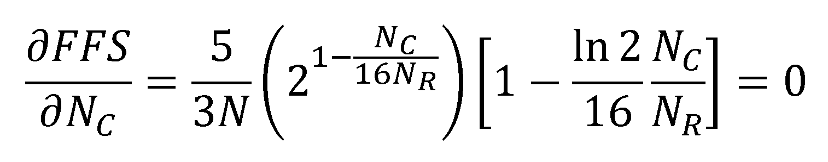
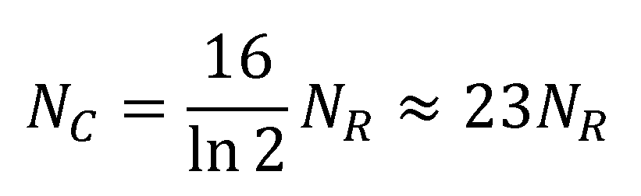
MISSION SUCCESS IS EVALUATED WITH FFS
(1)
(2)
(3)
If resources are limiting factor, Eq. (4) gives optimal number of colonists
(4)

Slide 4
DESIGN REQUIREMENTS
Primary Aircraft |  | Colonist Delivery Aircraft
Max. Weight | 55 lbs. | Max. Weight | 9 oz.
Wingspan | 12 feet | Control | 2 DOF, Autonomous
Propulsion Power | 750 W | Landing | Less than 50G
Volume | Fit 64 oz of water, 8 Habitats | Power | No propulsion
Drag | Low as possible | Volume | Fit ~30 Colonists
Airframe Weight | ~ 17 lbs. | Drag | Low
Drop Mechanism | Reliable | Deployability | Reliable

Slide 5
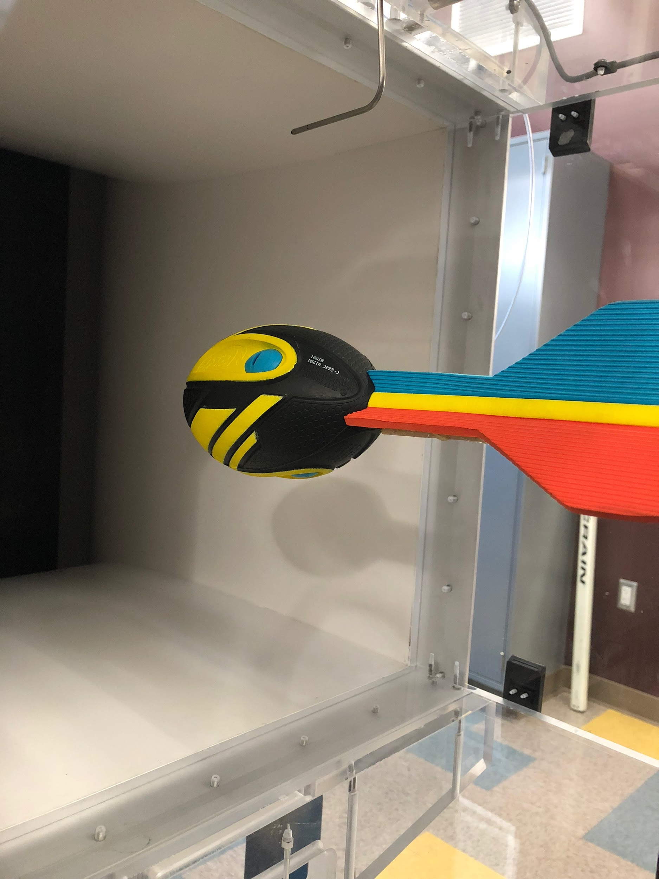
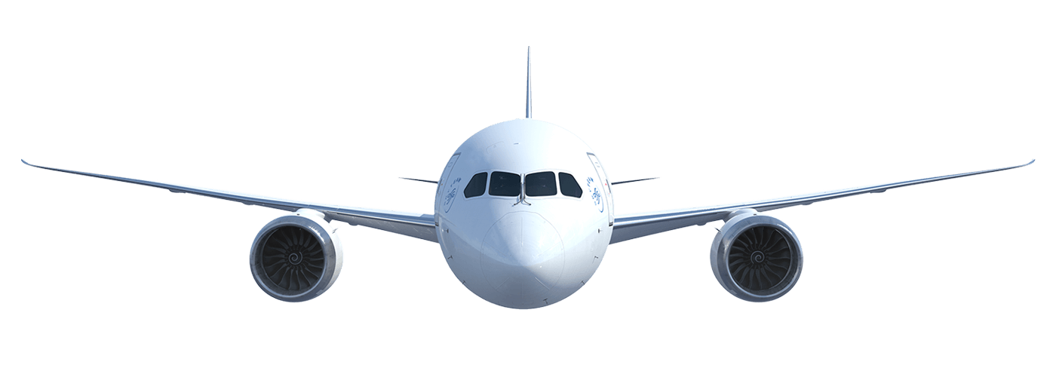
PRIMARY AIRCRAFT: WING & FUSELAGE DESIGN PROCESS
HABITAT & SUPPLY PAYLOAD MOUNTING REQUIREMENTS
Longitudinal - limited, 10” within EW CG of Primary Aircraft (nose to tail)
Lateral (along the span) - not limited
Spanwise loading
DESIGN PROCESS
Two design alternatives - externally/internally mounted
Experimentally determined Nerf Howler’s drag, 0.39lb @ 55 ft/s (3.1lb)
Dynamic payload has to be mounted internally
CONCLUSION
Spanwise, internal loading of the parasitic payload
Wind tunnel testing Nerf Howler in LMU’s fluids laboratory
Notes:
The design of the wing and fuselage was driven by two of the mission critical payloads - the nerf footballs and water bottles
These payloads are considered parasitic as they are do not generate lift
The competition imposes the following requirements on where these dynamic payloads are mounted on the airframe
Longitudinally, nose to tail, the payloads must be mounted within 10” of the PA’s EW CG
Laterally; along the span, there is no limitation
Payload can’t be loaded in a “slipstream” configuration
Therefore, the competition payload mounting regulation imposes spanwise loading (down the wings)
From this, the two top level design alternatives were; mount the payloads internally or externally
The drag over the nerf howler was quantified as a function of airspeed, the results of this experiment ruled out the external mounting alternative due to drag

Slide 6
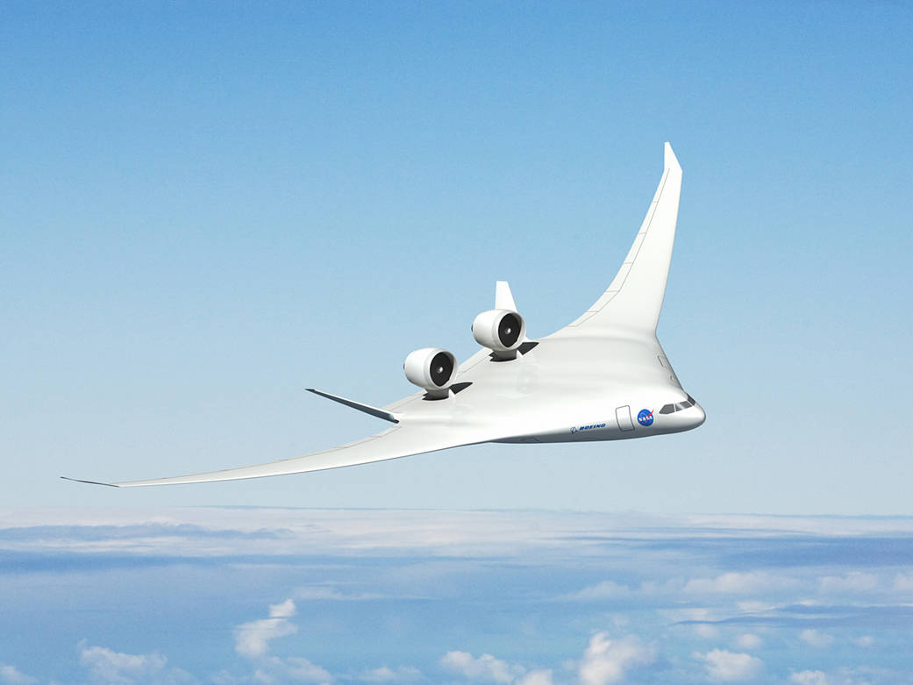
PRIMARY AIRCRAFT: INTERNAL SPANWISE LOADING
STORING THE DYNAMIC PAYLOAD IN THE WING(S)
Store mission payload in essential body
Remove fuselage - lower parasitic drag
Fully utilize limited 12’ wingspan (uninterrupted lifting body)
DESIGN DRIVERS & REQUIREMENTS
Store Nerf Howler (OD 3.5”)
Imposes thickness req.
Increases front area - Increases drag
Thicker central airfoil for storage (Blended Wing)
Thinner efficient high lift wings (Primary Wings)
Boeing & NASA’s blended wing body aircraft the X-48

Slide 7
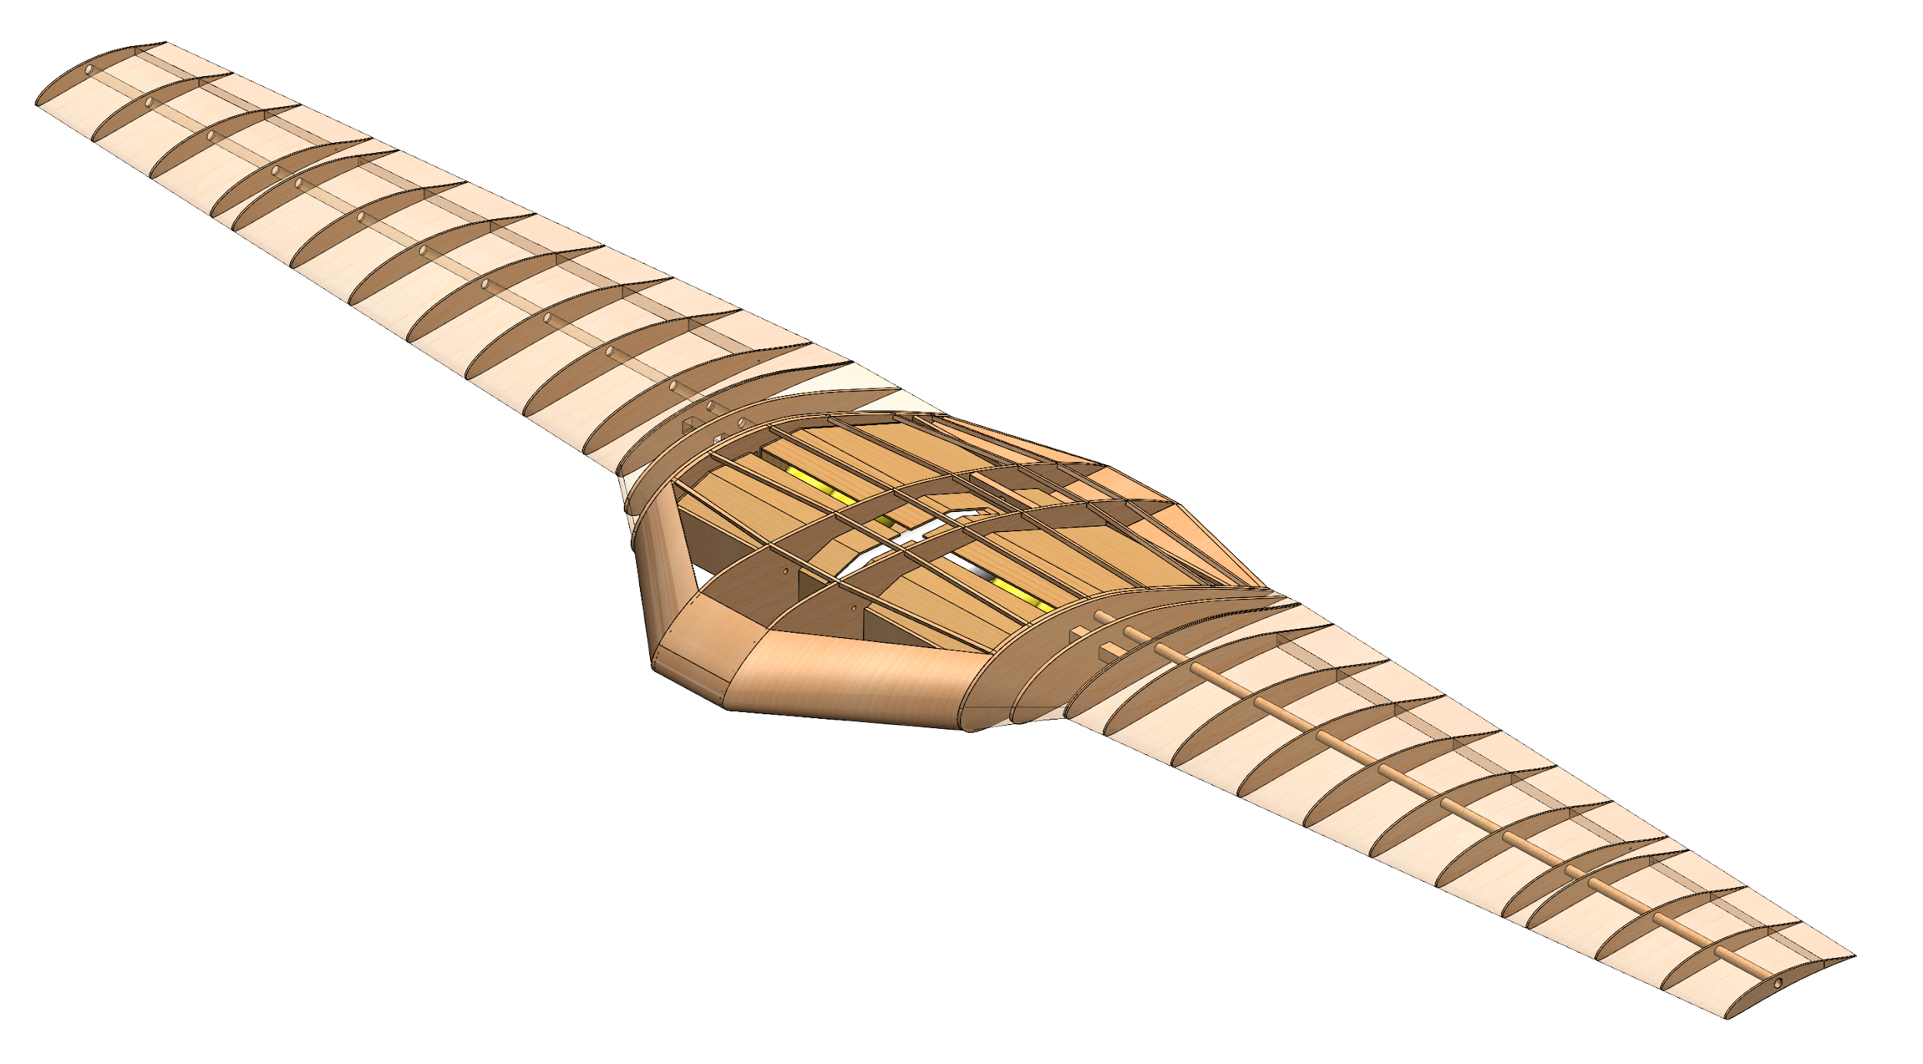
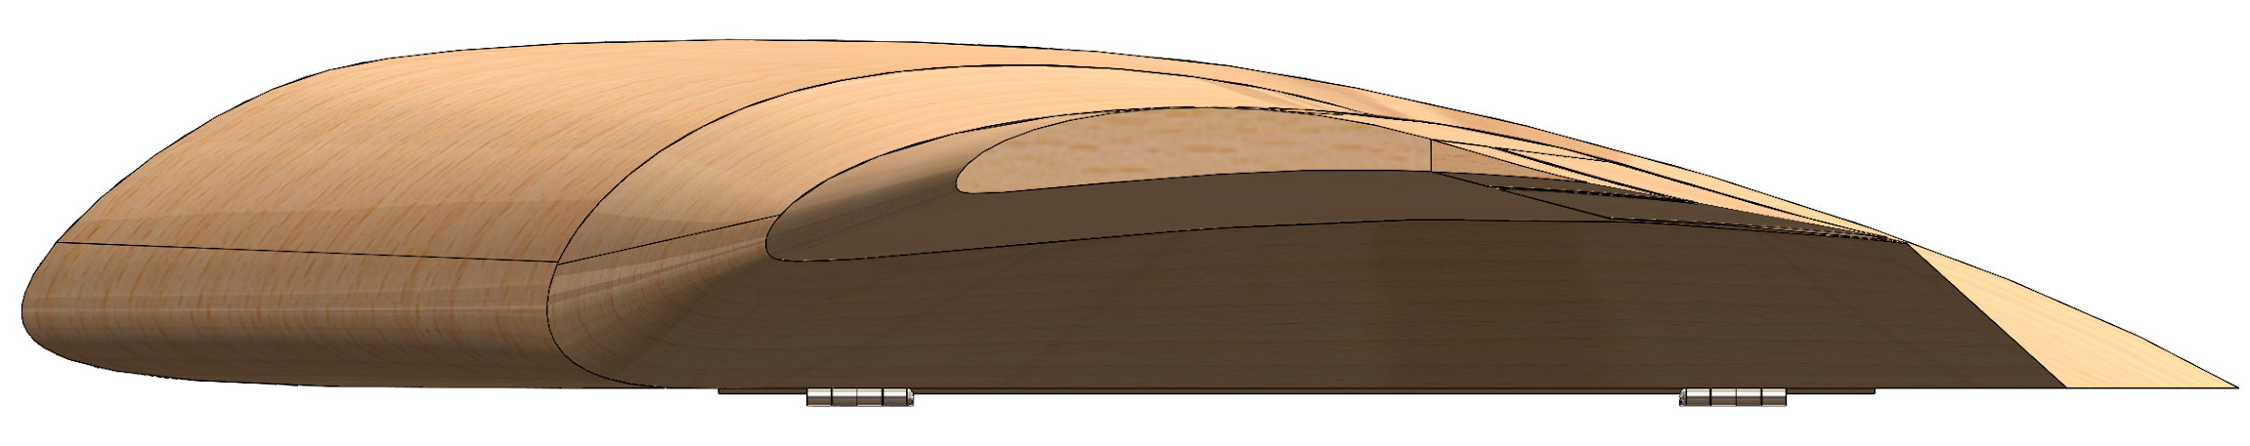
PRIMARY AIRCRAFT: BLENDED WING BODY
OUR DESIGN:
efficient high lift wings merged with a wide airfoil-shaped body (BWB)
Side view of BWB
Isometric view of BWB

Slide 8
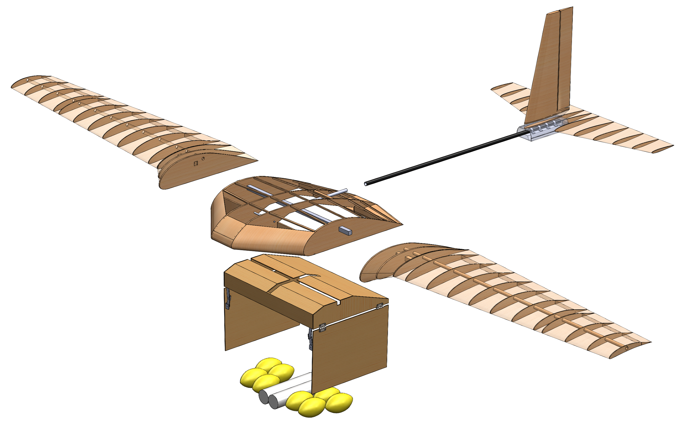
PRIMARY AIRCRAFT: AIRFRAME OVERVIEW
3.
TOP LEVEL AIRFRAME COMPONENTS
Blended Wing Body
Primary Wing(s)
Blended Wing
Dynamic Payload Bay
Static Payload Bay
Electronics Bay
Propulsion
Empennage
Landing Gear
1a.
1b.

Slide 9
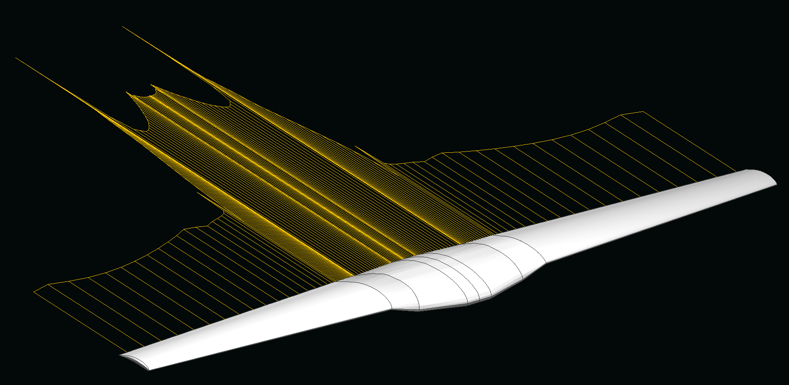
PRIMARY AIRCRAFT: BLENDED WING BODY OPTIMIZATION
FURTHER WORK
Stability
Aircraft controls
Optimization of CG placement
Aircraft Performance Optimization
Wing optimization (analytical/CFD/experimental)

Slide 10
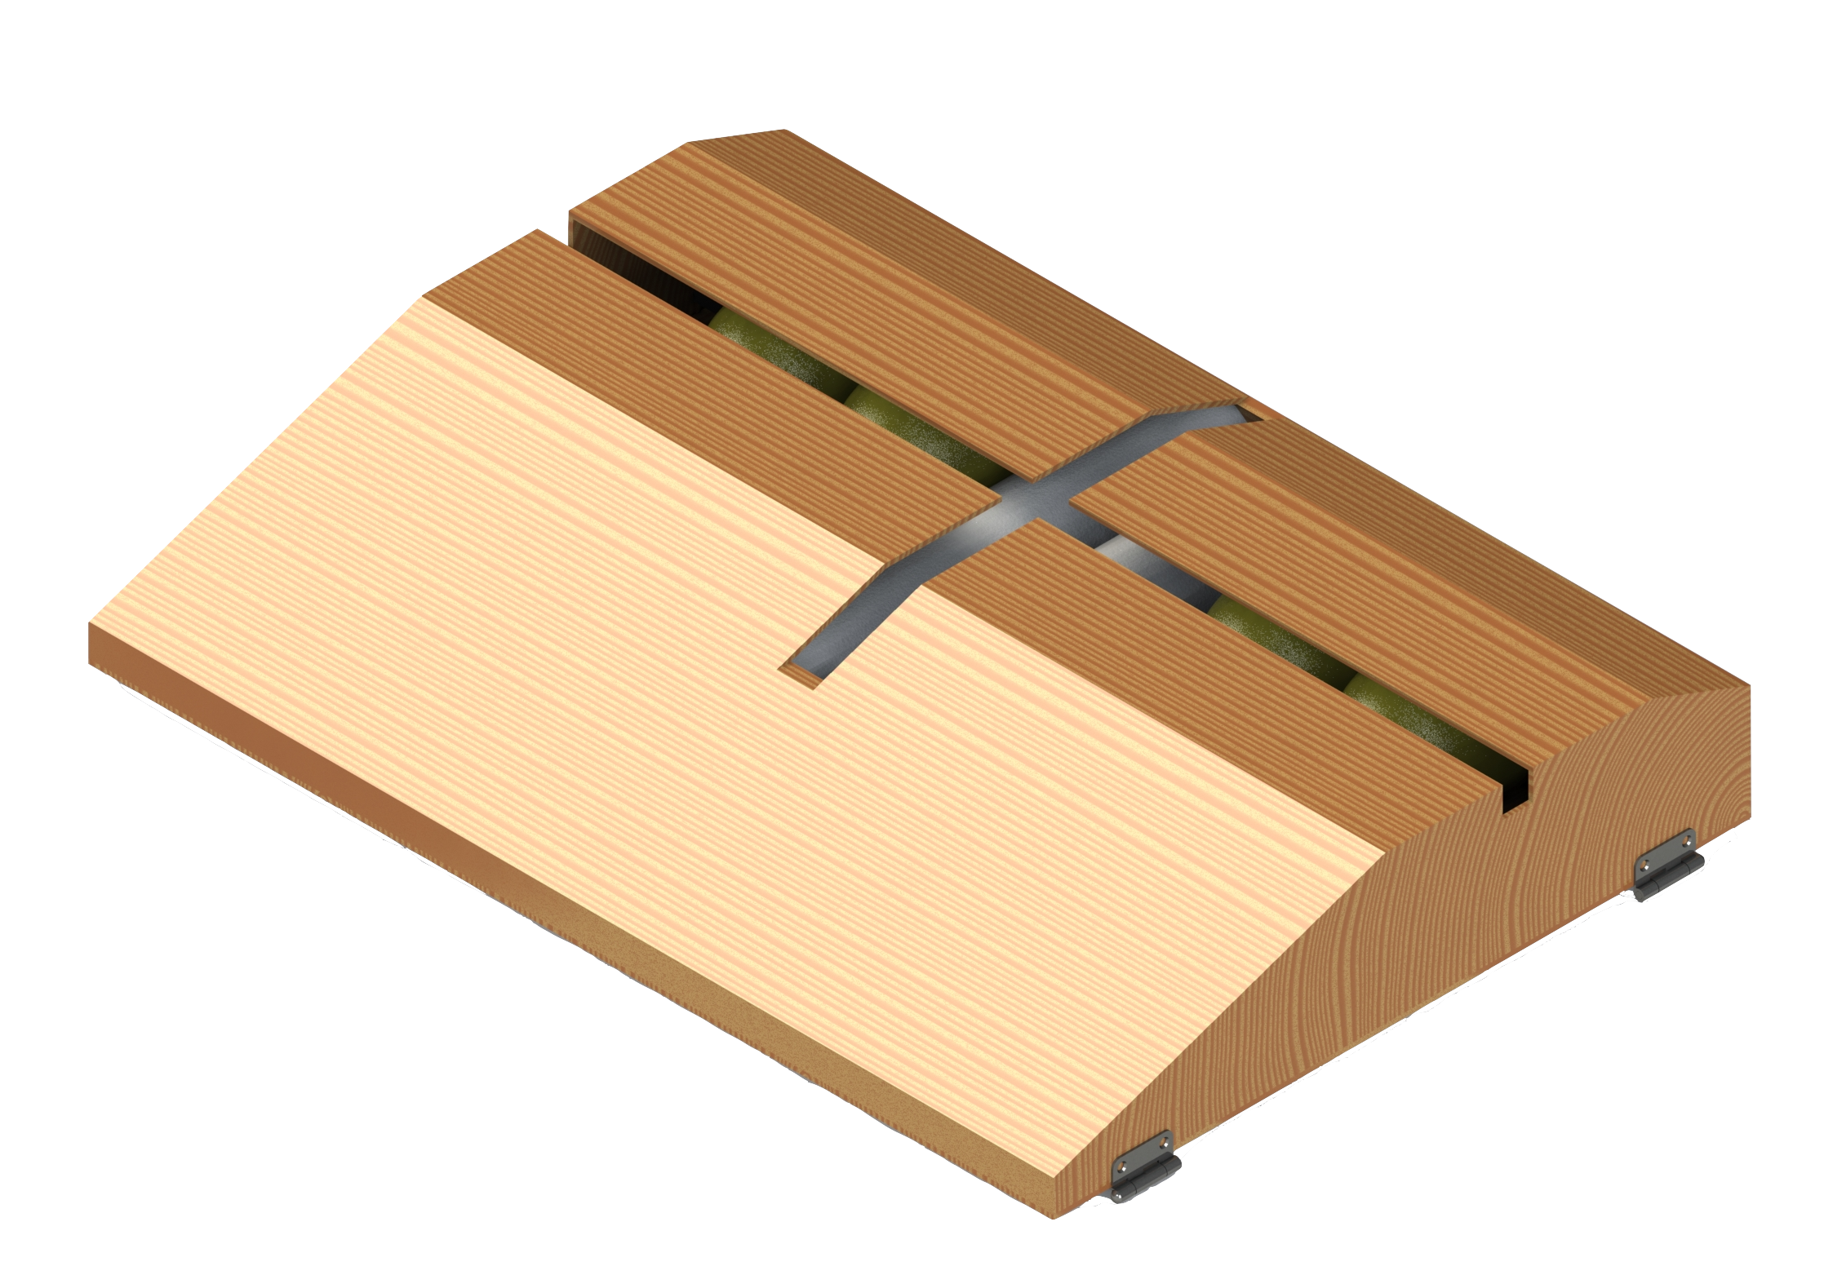
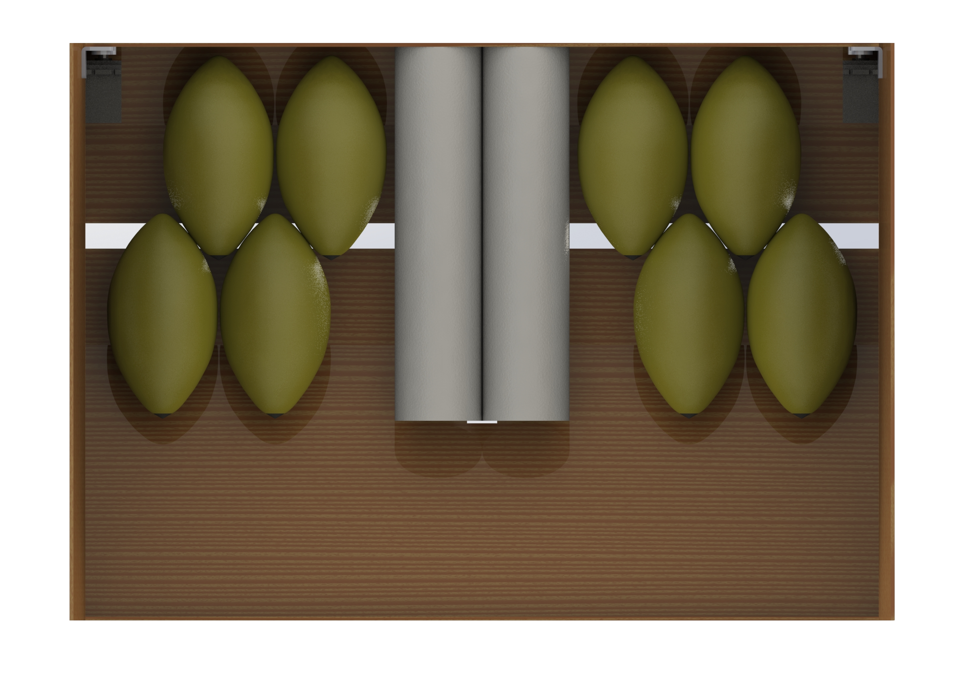
PAYLOAD BOX
Removable Payload Cartridge
Ease of loading
No need to flip aircraft to reload
Compact payload configuration
*Football tails not included

Slide 11
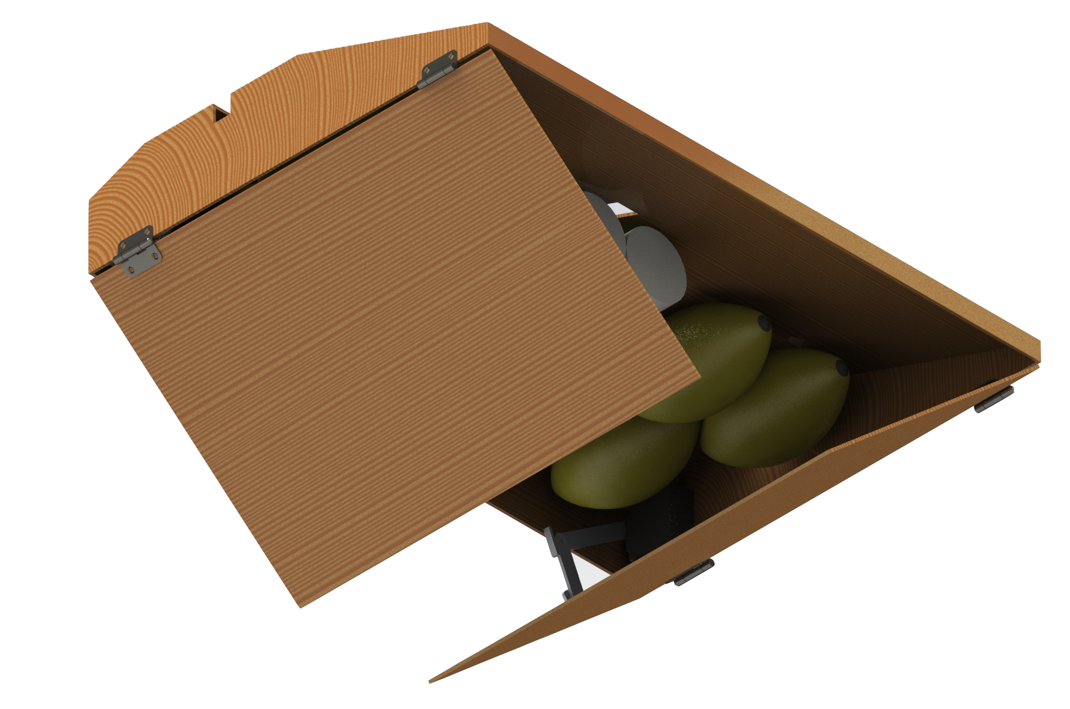
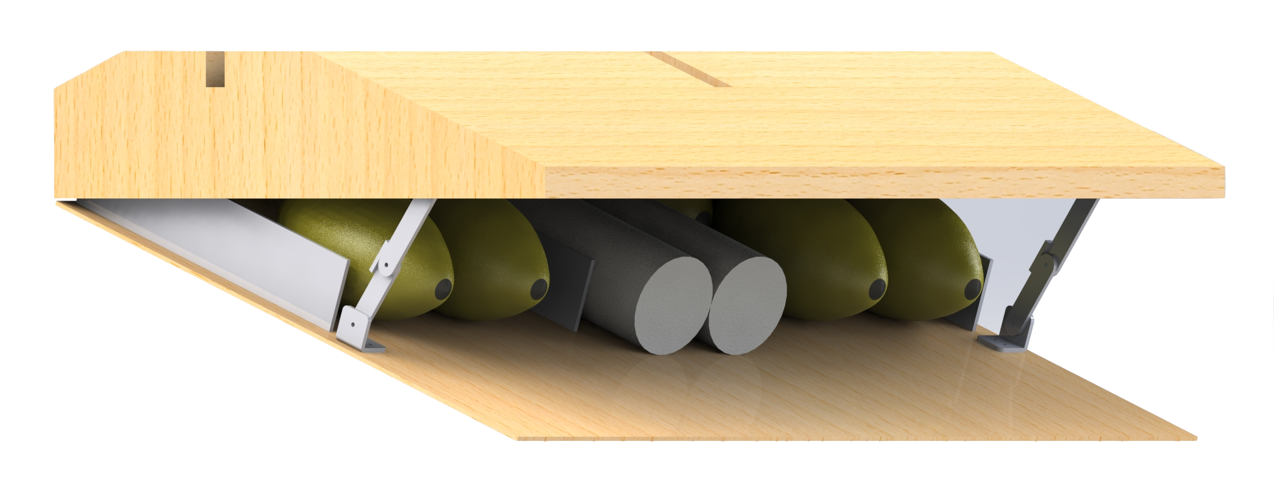
DROPPING MECHANISM
First Iteration
Most compact and simple design
Large amount of drag
Door opens into free stream
Acts as a large slit flap
Causing pitch up
Second Iteration
Less Drag
Door doesn’t open into free stream
Electronics/Mechanisms harder to fit
Future Considerations
Servo Ratchet
Latch Design
Motor instead of servos?

Slide 12
DROPPING MECHANISM (FMEA)
Failure | Effect of Failure | Sev | Cause | Prevention
Door doesn’t open | Loss of points | 3 | Servo stripping or burning from overuse | Care when servos are not powered. Test movement prior to takeoff
Door doesn’t close | Potential crash or fracture of doors on landing | 8 | Ratchet doesn’t engage. Servo stripping | High quality, metal gear servos. Through testing of ratchet system.

Slide 13
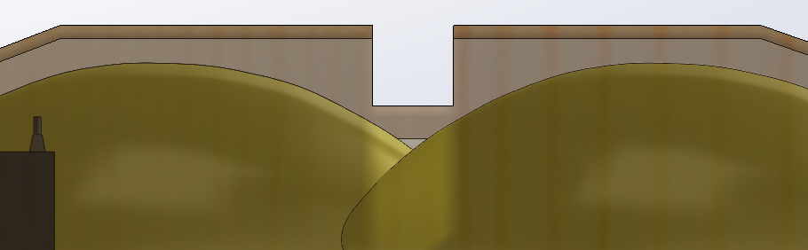
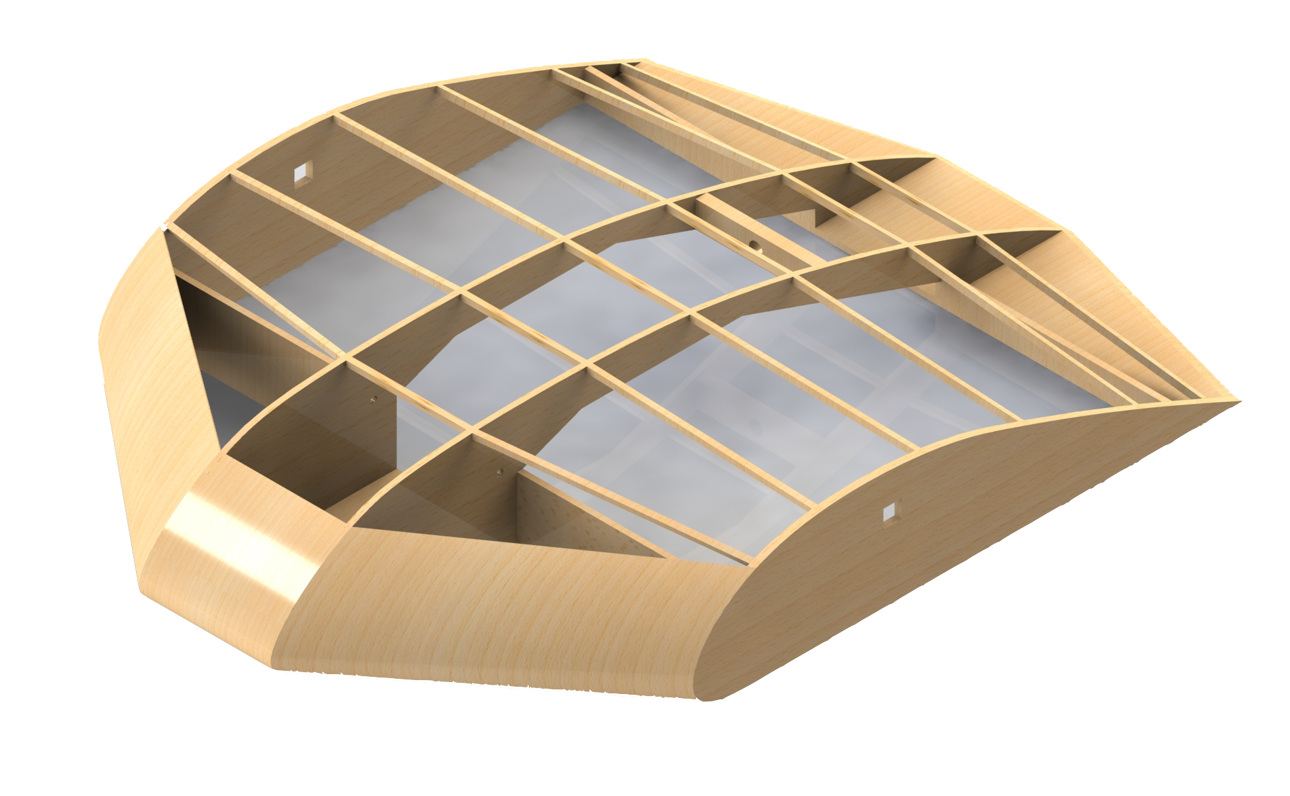
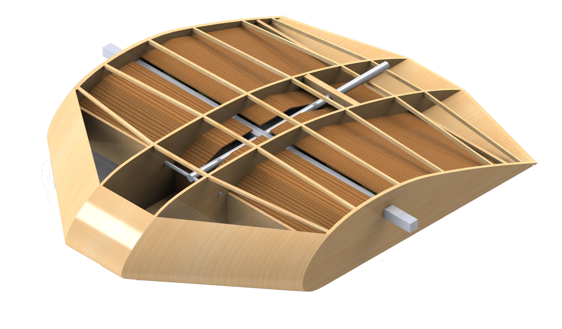
FUSELAGE STRUCTURE (BLENDED WING)
Size of shell minimized to reduce drag
Imposes space restrictions for structure
0.25” side walls and base plates (Basswood)
Addition of nose
Fix CG and add room for electronics
Future
Further structural analysis (FEA)
Finalize spar sizing and attachment method
Space limitation for spar
*Material contrast added for clarity

Slide 14
FUSELAGE STRUCTURE (FMEA)
Failure | Effect of Failure | Sev | Cause | Prevention
Main Spar Fracture | Likely crash. Loss points and ability to compete | 10 | Fatigue, aerodynamic flutter, stress concentration at attachment point | Factor of safety, thorough testing (experimental and computational)
Payload Bay Dettaches | Loss of points, potential crash | 7 | Wearing of threads in wood due to continuous screwing | Tear out analysis, use of T-Nuts to provide metal threads.
Base Plate Fracture | Replacement of parts, minor crash | 5 | Hard landing, plate not thick enough | Further FEA analysis, soft landings

Slide 15
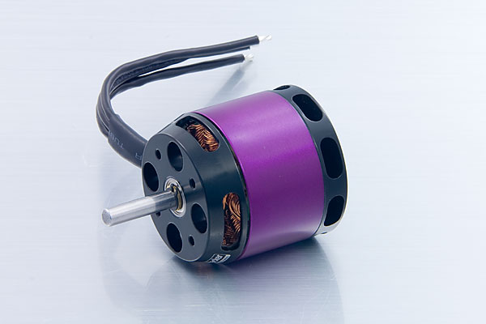
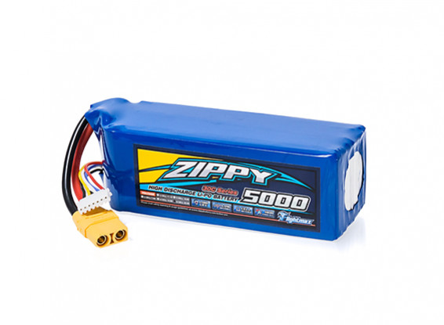
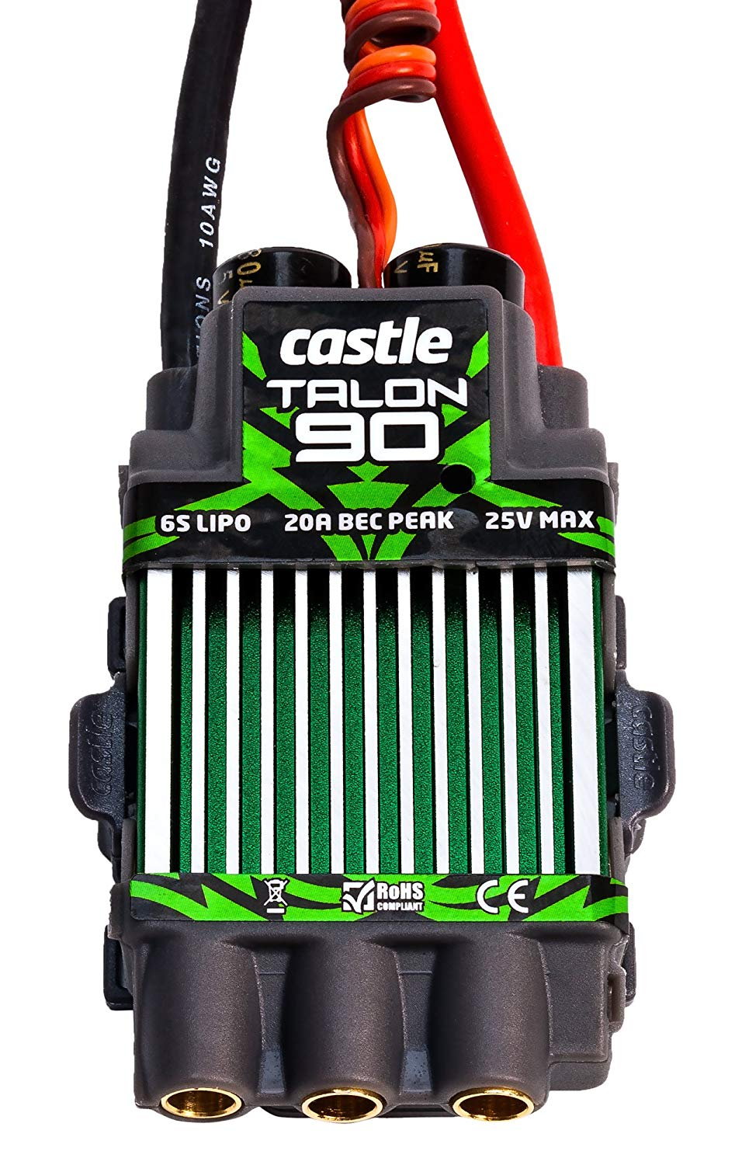
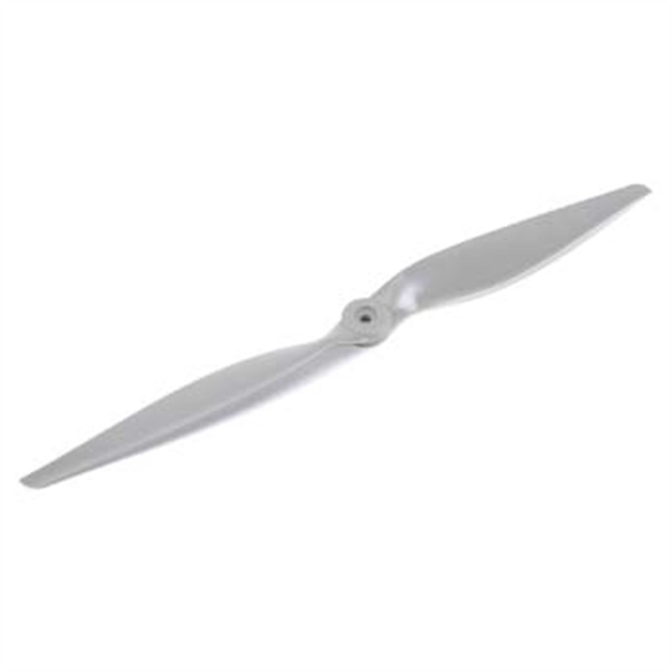
POWERTRAIN COMPONENTS
Hacker A40-14s Brushless motor
Castle Talon 90 ESC
6 cell LiPo Battery
APC nylon propeller

Slide 16
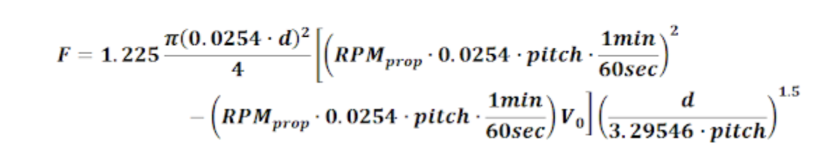
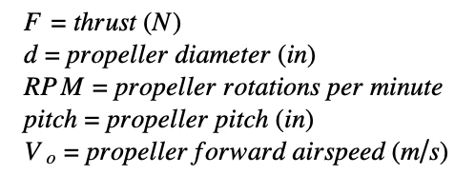
THRUST CALCULATIONS

Slide 17
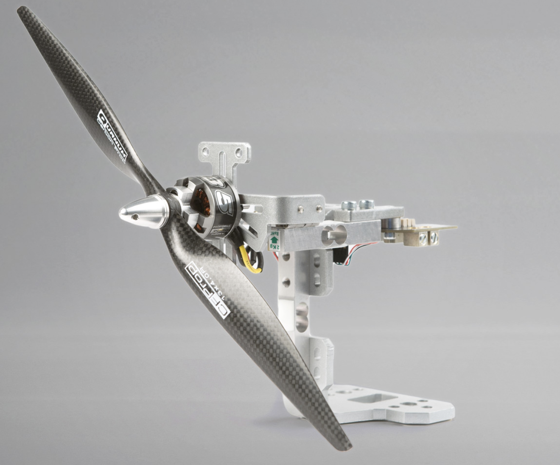

THRUST STAND TESTING
Finalized motor configuration
One vs two motors
Tested multiple propellers
Future Testing:
Test other propellers
Perform dynamic thrust tests

Slide 18
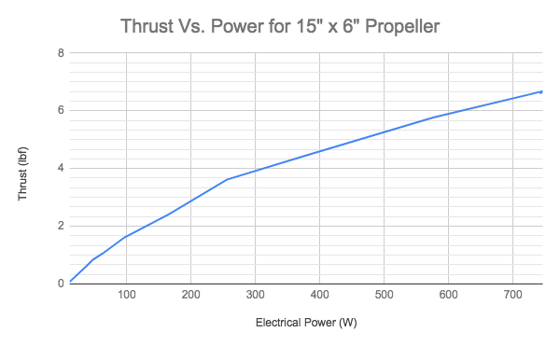
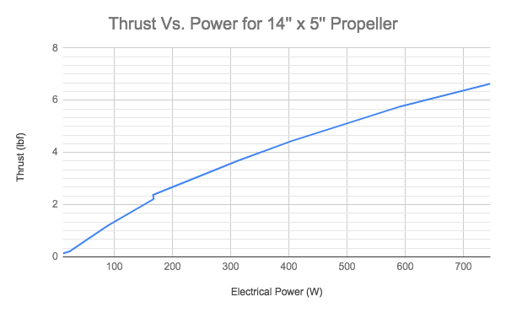
THRUST TESTING RESULTS
Similar performance from both propellers
Test lower pitch
Dynamic thrust tests to finalize propeller choice

Slide 19
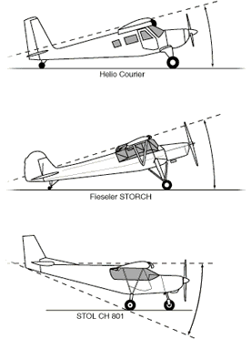
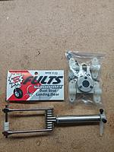
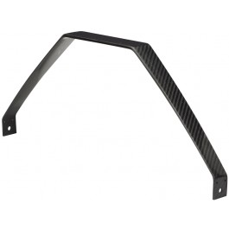
LANDING GEAR
Tricycle layout
Ground control
Take off performance
Quickly build ground speed
Easier to land
Rear landing gear
Carbon fiber to reduce weight
Full U shape to distribute load
Nose gear
Aluminum for strength
Success with Fults gear in previous years

Slide 20
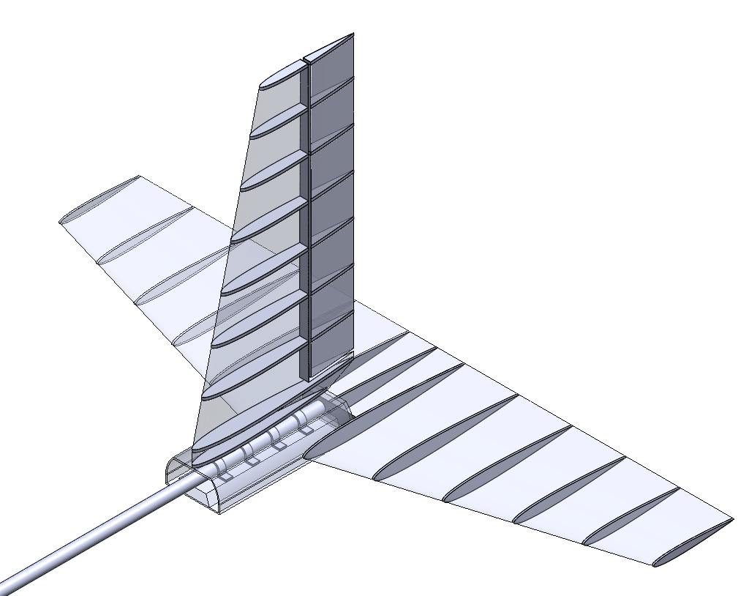
TAIL ASSEMBLY
Critical for pitch and yaw maneuverability
Emphasis on manufacturability, weight, drag, and stability
Conventional tail with a stabilator
Notes:
-tail assembly is critical for trim control, pitch and yaw maneuverability, countering the moment produced from the wing, and in-flight stability
-emphasis was placed on tail configurations that were easy to build,lightweight, created low drag, and stable
-after screening designs we decided to move forward with a conventional tail with a stabilator and here’s why

Slide 21
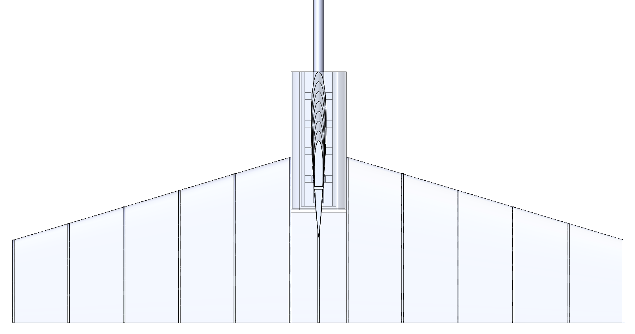
HORIZONTAL STABILATOR
More effective control surface
Lighter than a stabilizer/elevator combination
Reduced drag
NACA 0009 airfoil
Design Points
Notes:
-a stabilator, or all-moving tail, combines the stabilizer and elevator into one moving surface
-we chose a stabilator because it is a cleaner design which effects several things
-there is a more effective control surface which means that smaller deflections are necessary to change pitch
-it is lighter since hinge connectors and one less servo is removed
-reduced interference drag which results in a higher speed and lift capacity
-design points can be obtained by putting emphasis on tail design and optimization

Slide 22
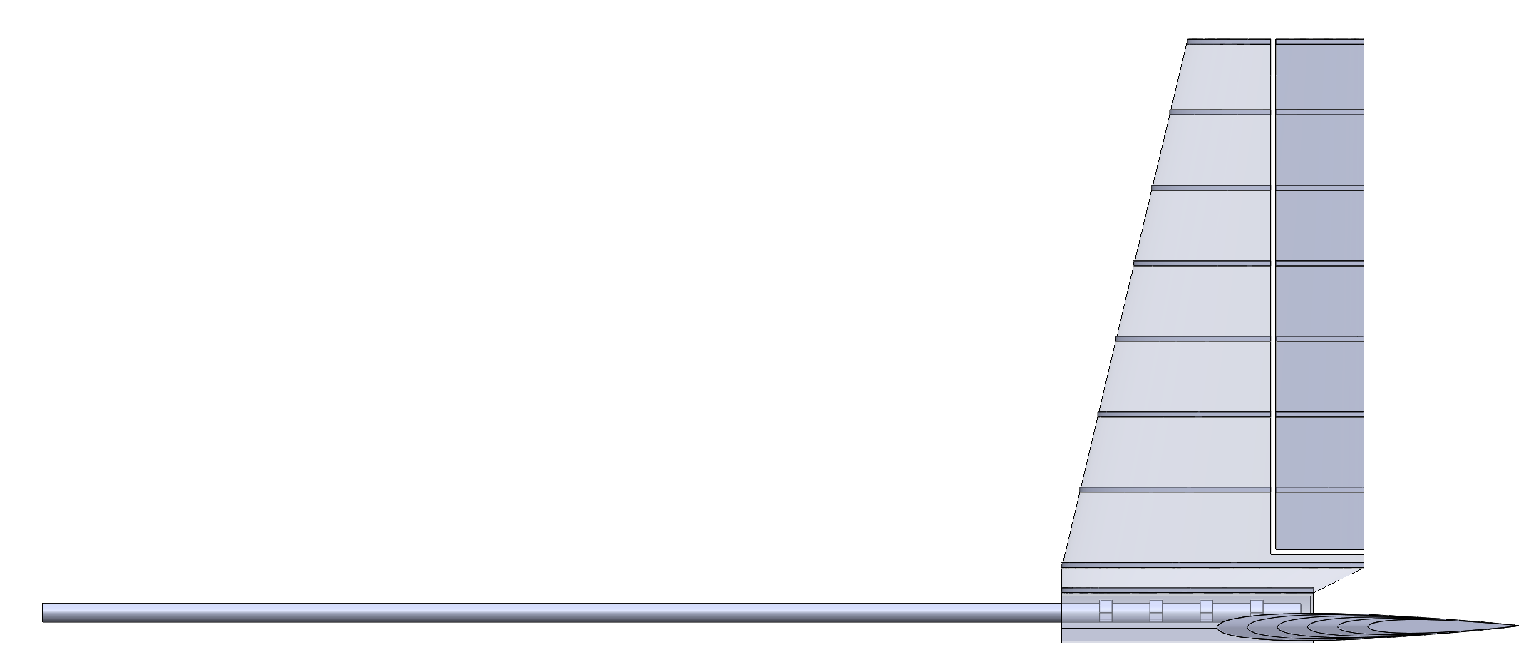
VERTICAL FIN
NACA 0009 Airfoil
Rudder is 30% of the vertical tail area
Taper ratio of .6
20” tall

Slide 23
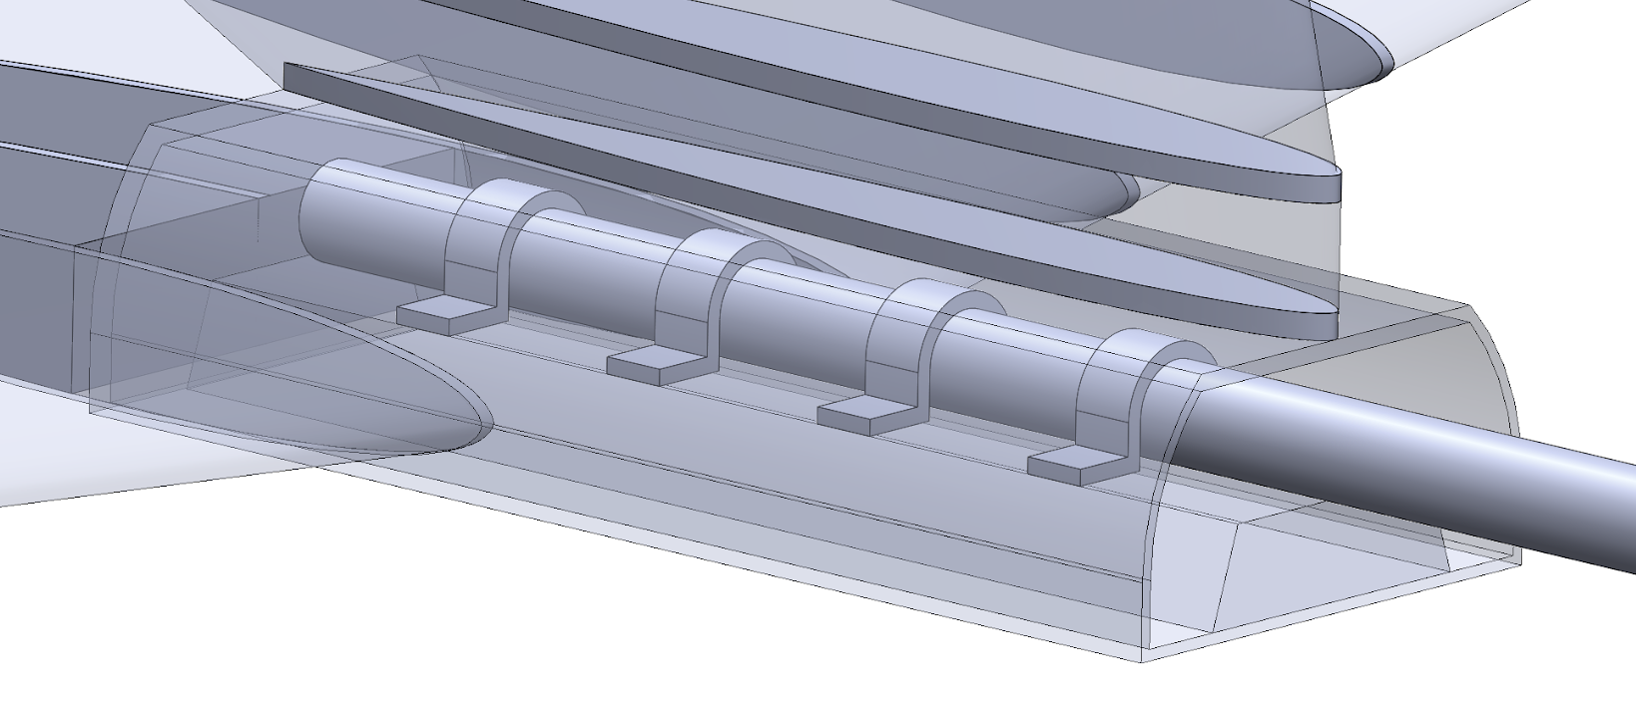
TAIL HOUSING
Lightweight Structural Connection
Minimize Volume
Optimize
Transition to Stabilizers

Slide 24
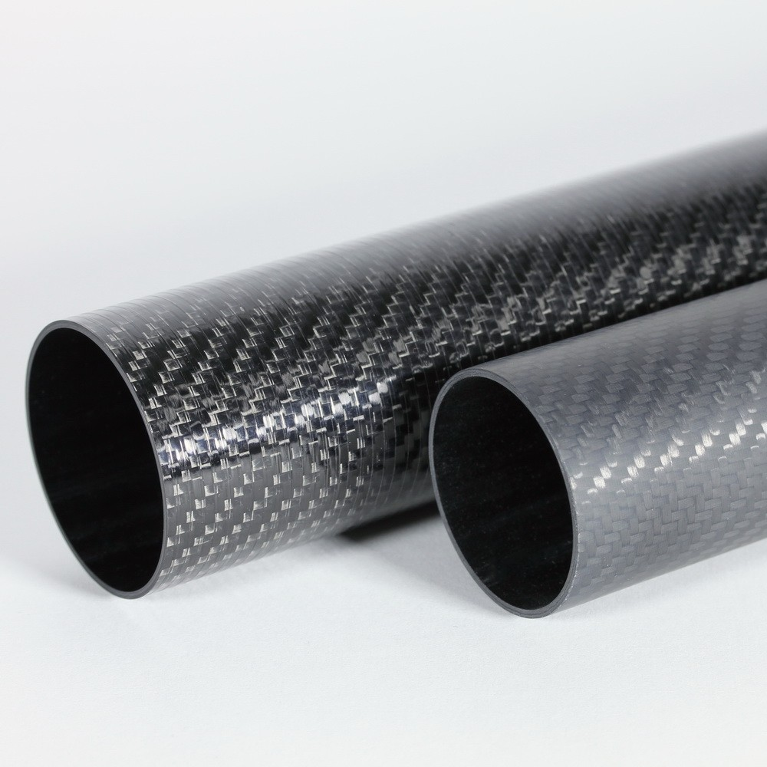
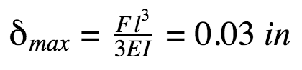
TAIL BOOM
Critical Considerations:
Weight
Deflection
Durability
Aluminum vs. Carbon Fiber
Various Multi-Layered Unidirectional Moduli Carbon Fibers
Final Decision: 1 1/4″ X 1 3/8″ Ultra High Modulus Carbon Fiber Tube
Notes:
Weight = CG criticality to design
Deflection = Small force, substantial moment arm
Durability = Crash considerations
Various Carbon Fibers: Standard → 34 Msi, Moderate → 42 Msi, High → 57 Msi, Ultra High → 94 Msi

Slide 25
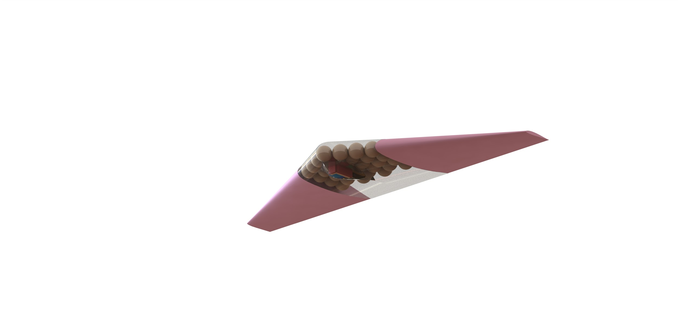
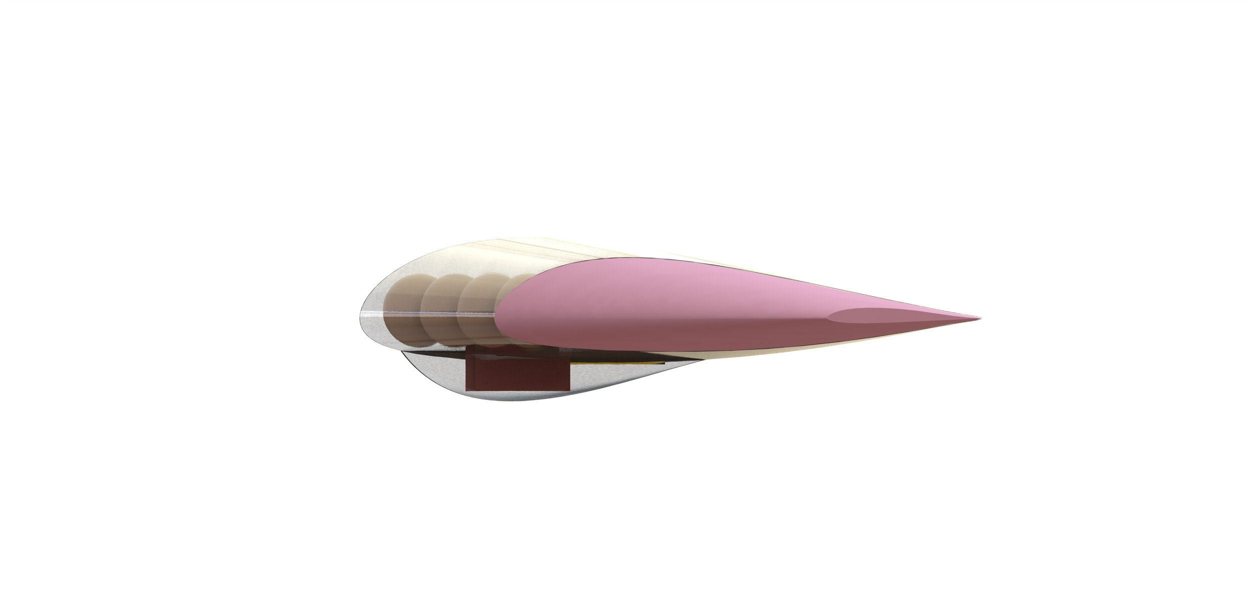
COLONIST DELIVERY AIRCRAFT (CDA)
Flying wing configuration
Structurally efficient colonist packing
Low drag
Potentially weight-efficient control system
Foam wings
Airframe:
Foam wings
Plastic monocoque passenger cabin
Thin wall 3d print
Colonists
in passenger cabin
Electronics

Slide 26
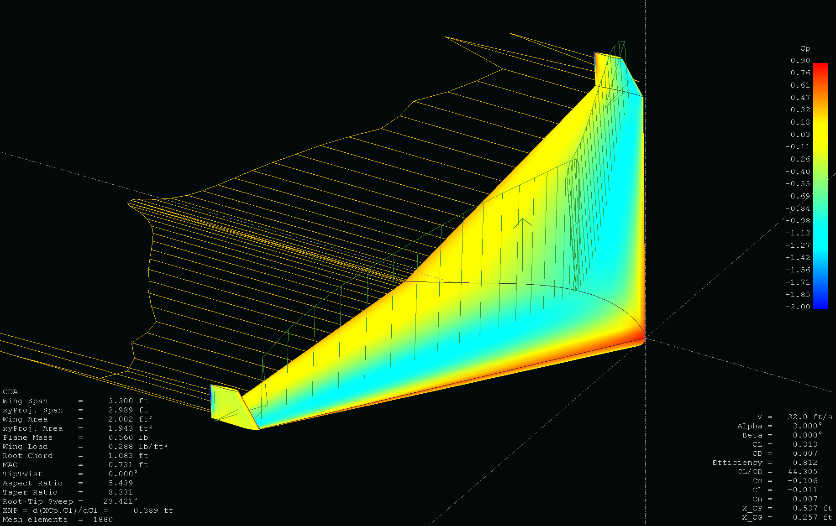
AERODYNAMIC PERFORMANCE
Simulated in XFLR5
Approximate span efficiency, coefficient of lift, and stability characteristics
Dihedral is advantageous for yaw stability
Vertical stabilizer is necessary
Winglets or vertical tail
Otherwise longitudinally stability modes well damped
Possible concerns for dutch roll and spiral stability modes

Slide 27
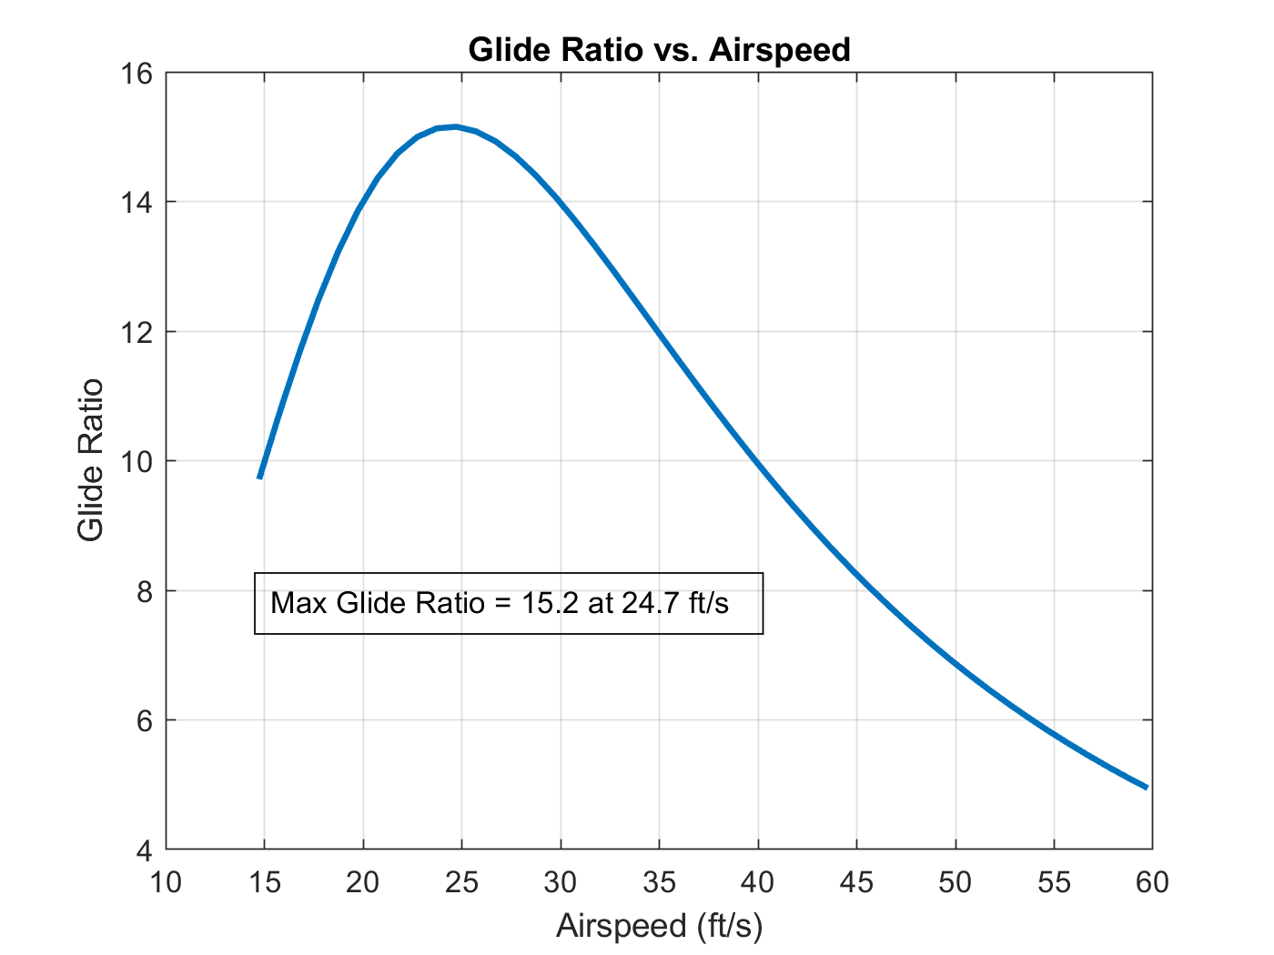
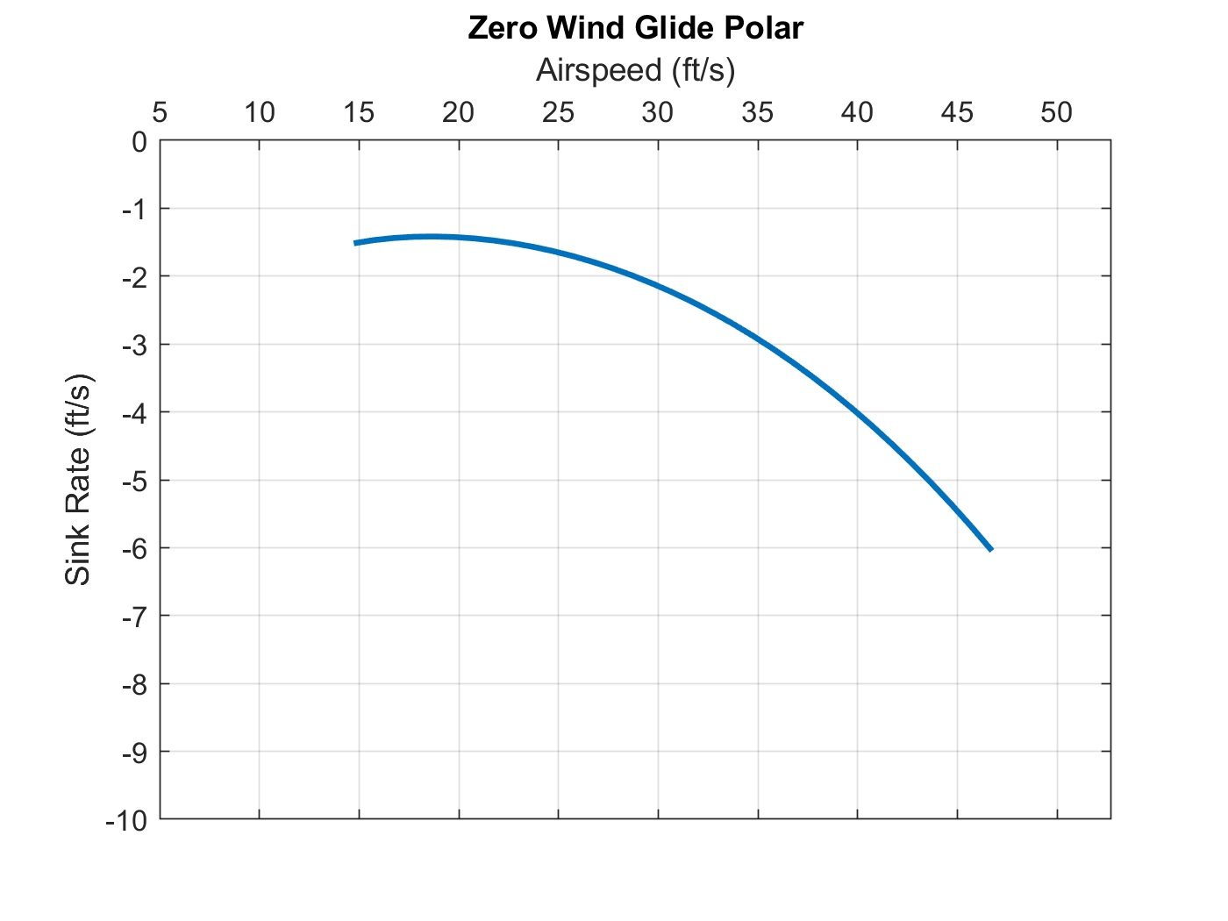
THEORETICAL GLIDE PERFORMANCE
Minimum necessary glide ratio = 1.5
Underestimates parasitic drag
With 3x worse drag, glide ratio is still over 9
Stall
50G impact w/ ground

Slide 28
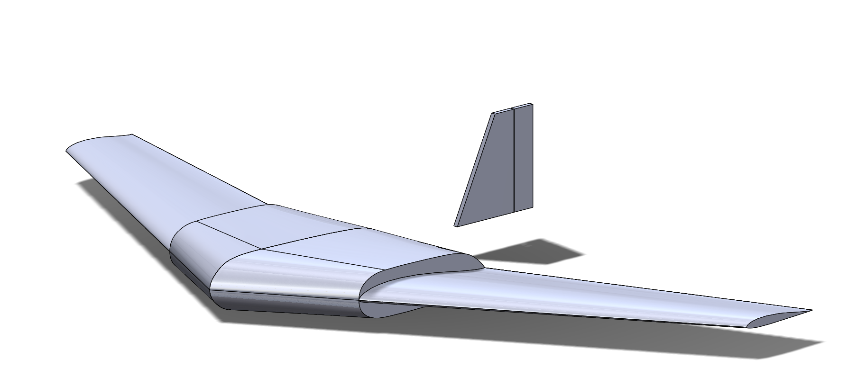
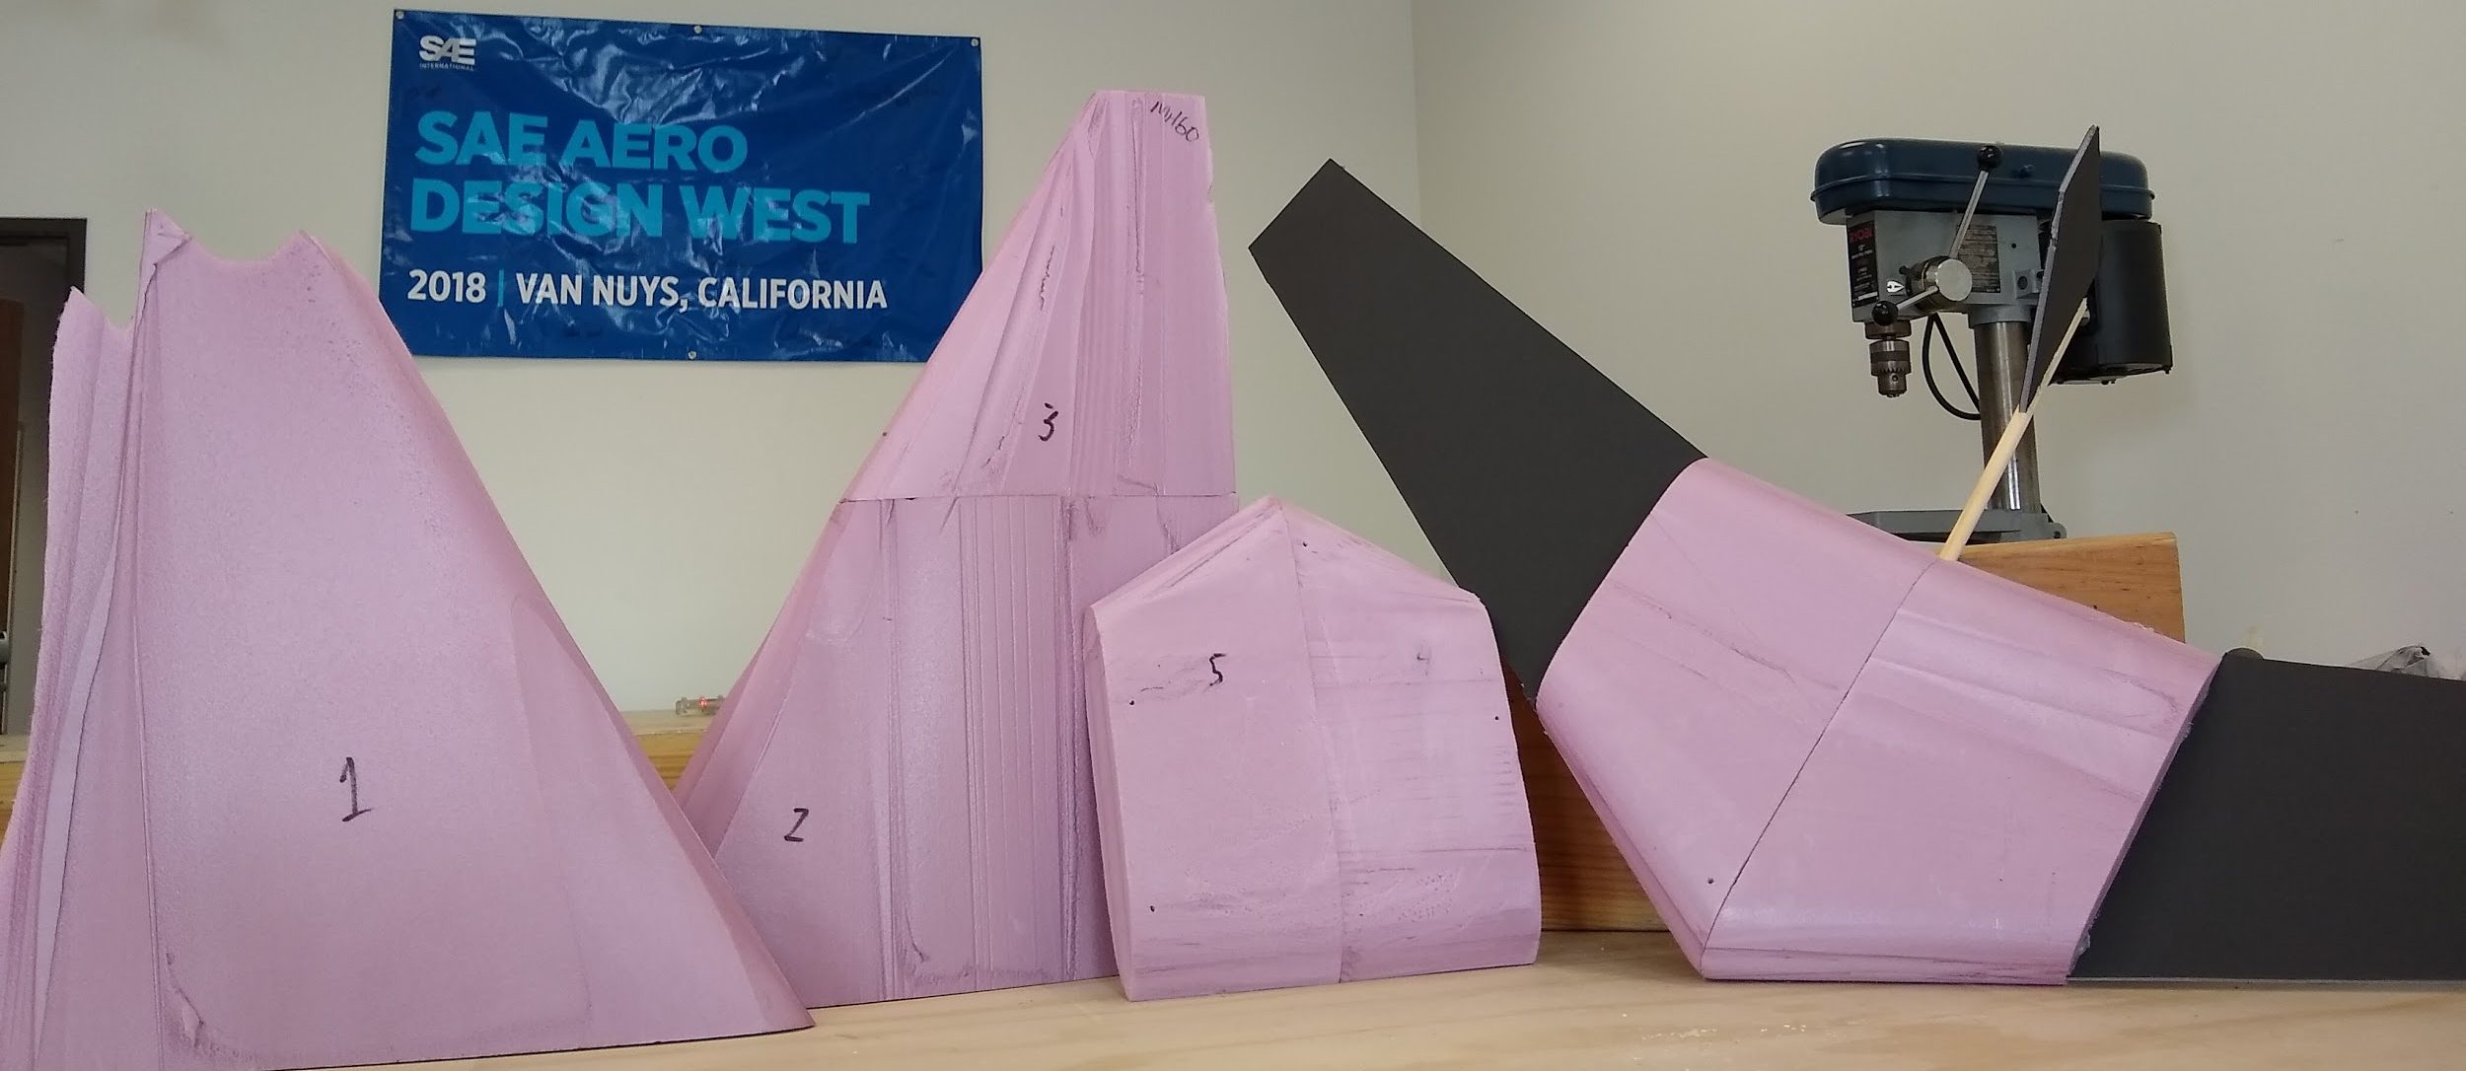
DESIGN PROTOTYPING AND TESTING
Flight & glide testing
Install motor and rc electronics
Fly to speed and altitude, kill throttle
Glide to target
Evaluate its control and performance in real flight in operational environment
Possible vertical tail & rudder
Parameters to test:
Can it fly?
Can it fly well?
Wing shape and sizing
Control surfaces
Elevons vs. elevator w/ rudder
Elevons w/ rudder
Controlled landing methods
Under 50G
Passenger cabin
Interchangeable wings
Prototype design with hot wired foam

Slide 29
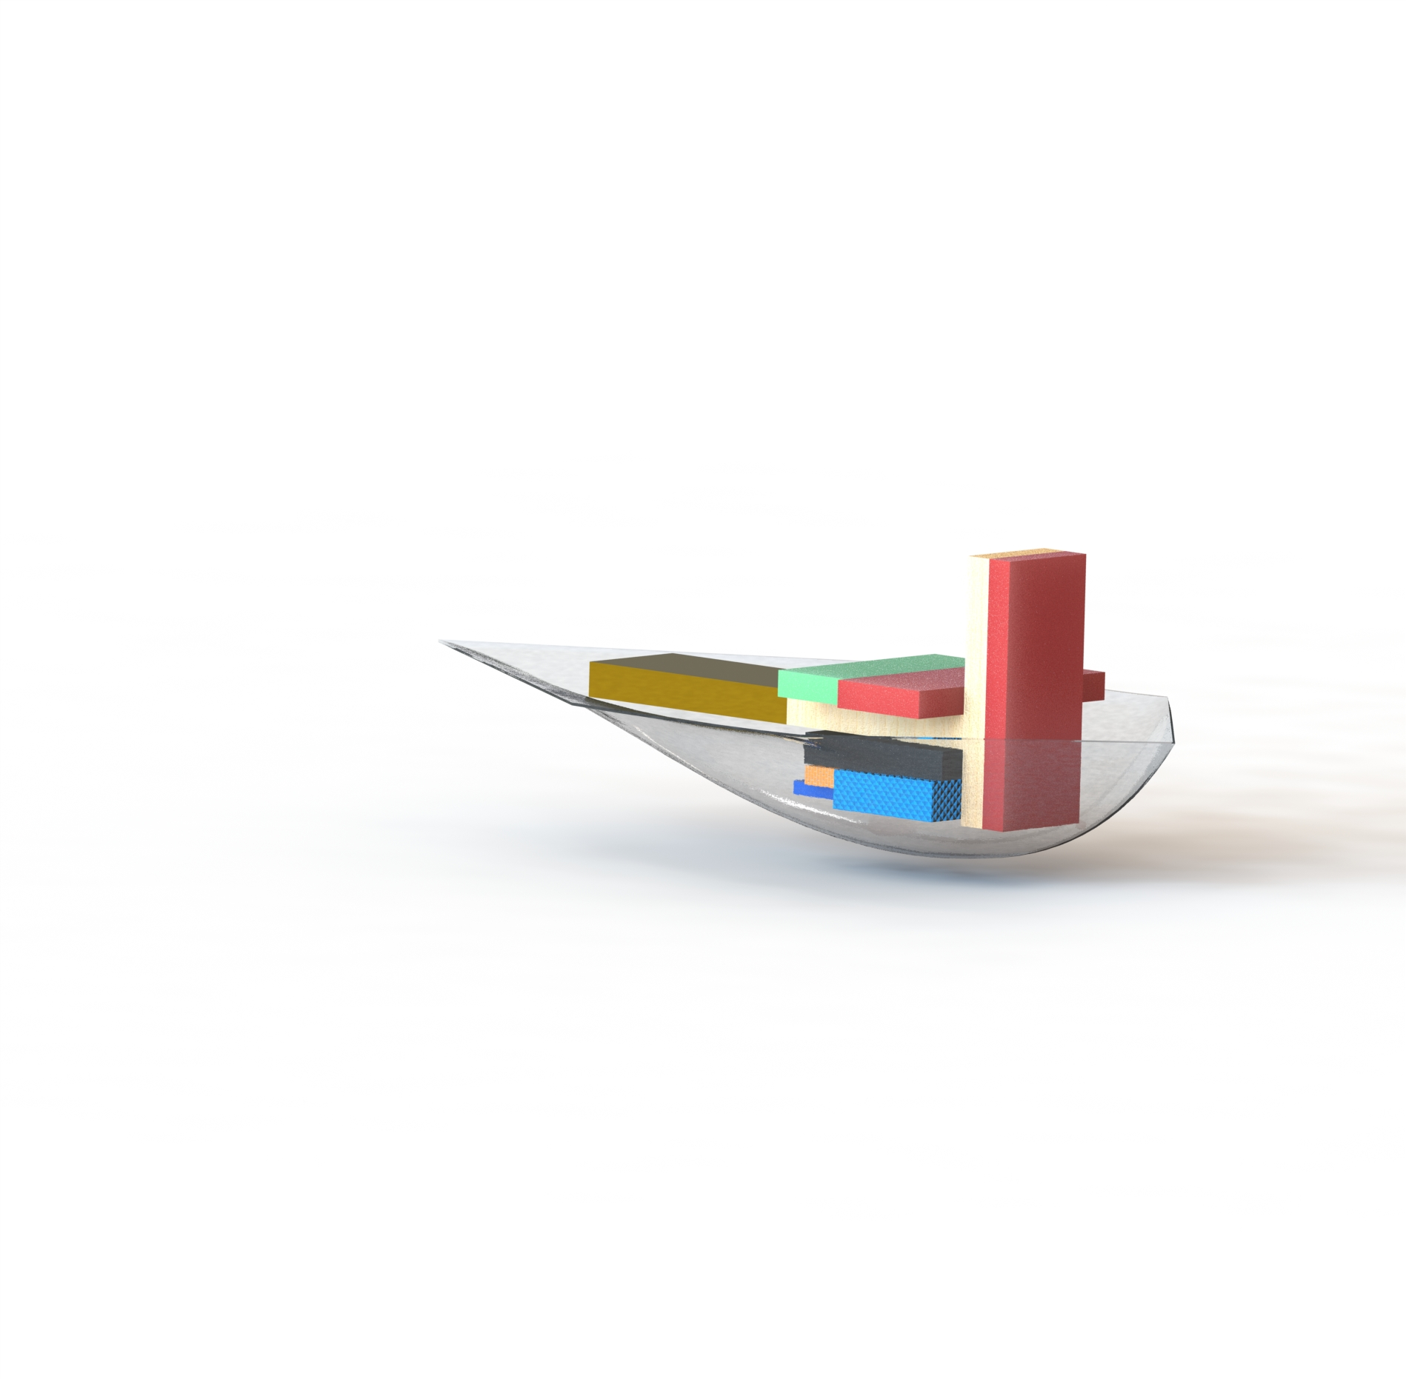
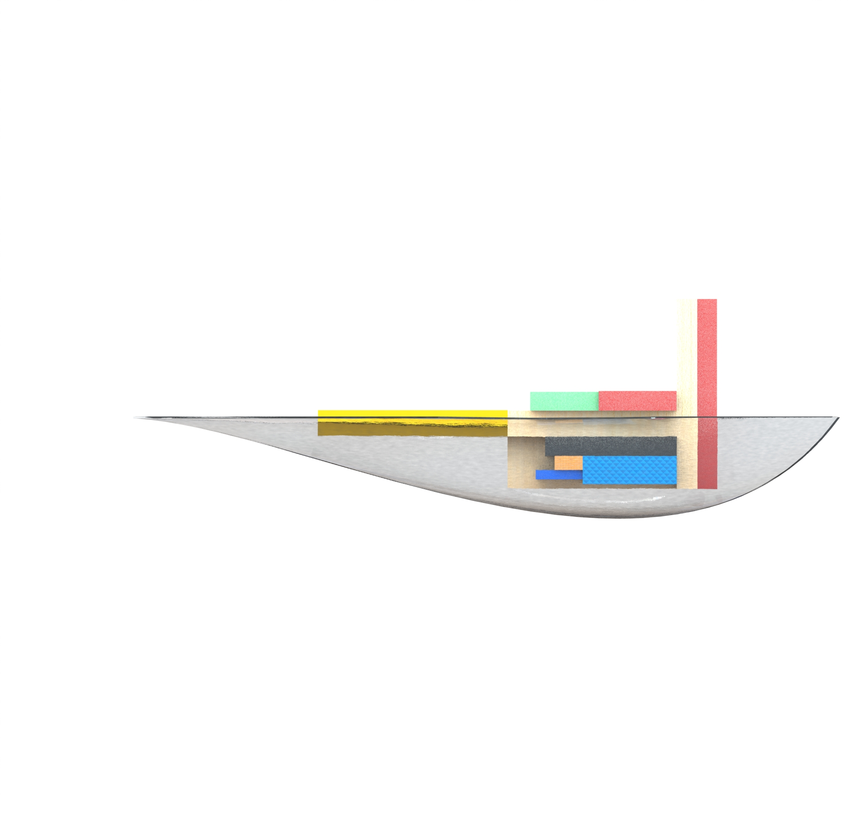
ELECTRONICS & BLISTER
Electronics on-board each CDA
Arduino Nano
Accelerometer
GPS Module
GPS Module Coin Cell
xBee Pro
3.7 V 350 mAh LiPo Battery (for components)
xBee Pro Breakout Board
Servos
Servo LiPo battery

Slide 30
CDA WEIGHT
Part | Weight (oz)
Electronics | 2.079
Foam Wings | 1.003
Passengers | 2.857
Impacts Sensors | 0.480
Electronics Mount | 0.093
Passenger Cabin | 0.232
Total | 6.744

Slide 31

TOTAL BUDGET

Slide 32

SCHEDULE

Slide 33

MOVING FORWARD
Questions?

